Slide 1

Distributed Transaction
Computer System Engineering, Fall 2019. (IPADS, SJTU)
Atomicity across multiple sites
Yubin Xia

Slide 2
Goal: Build Reliable Systems from Unreliable Components
The abstraction that makes that easier is transactions, which provide atomicity and isolation, while not hindering performance
all-or-
nothing
shadow copies (simple, poor performance) or logs (better performance, a bit more complex)
before-or after
2PL (Two-phase locking) ,
or OCC (Optimistic Concurrency Control)
eventually, we also want transaction-based systems to be distributed: to run across multiple machines

Slide 3
multi-site Transaction

Slide 4
Transaction across Multiple Sites
The setup
Client + coordinator + two servers
One server handles A-M
The other server handles N-Z
Coordinator and servers all have logs
Coordinator passes messages from the client to the appropriate server

Slide 5
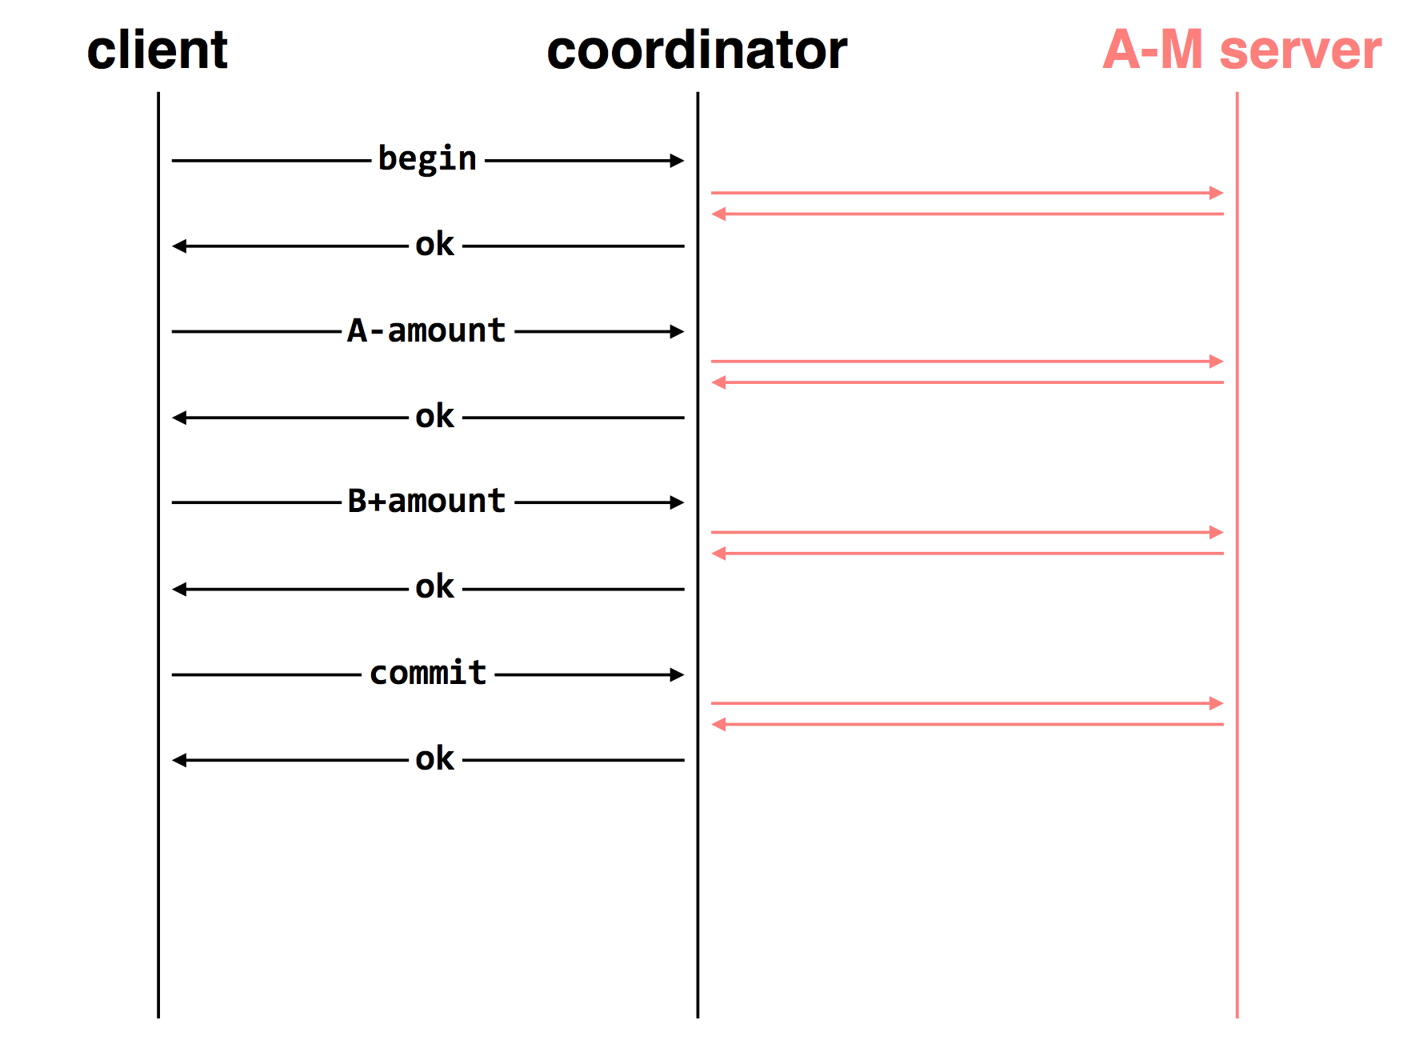

Slide 6
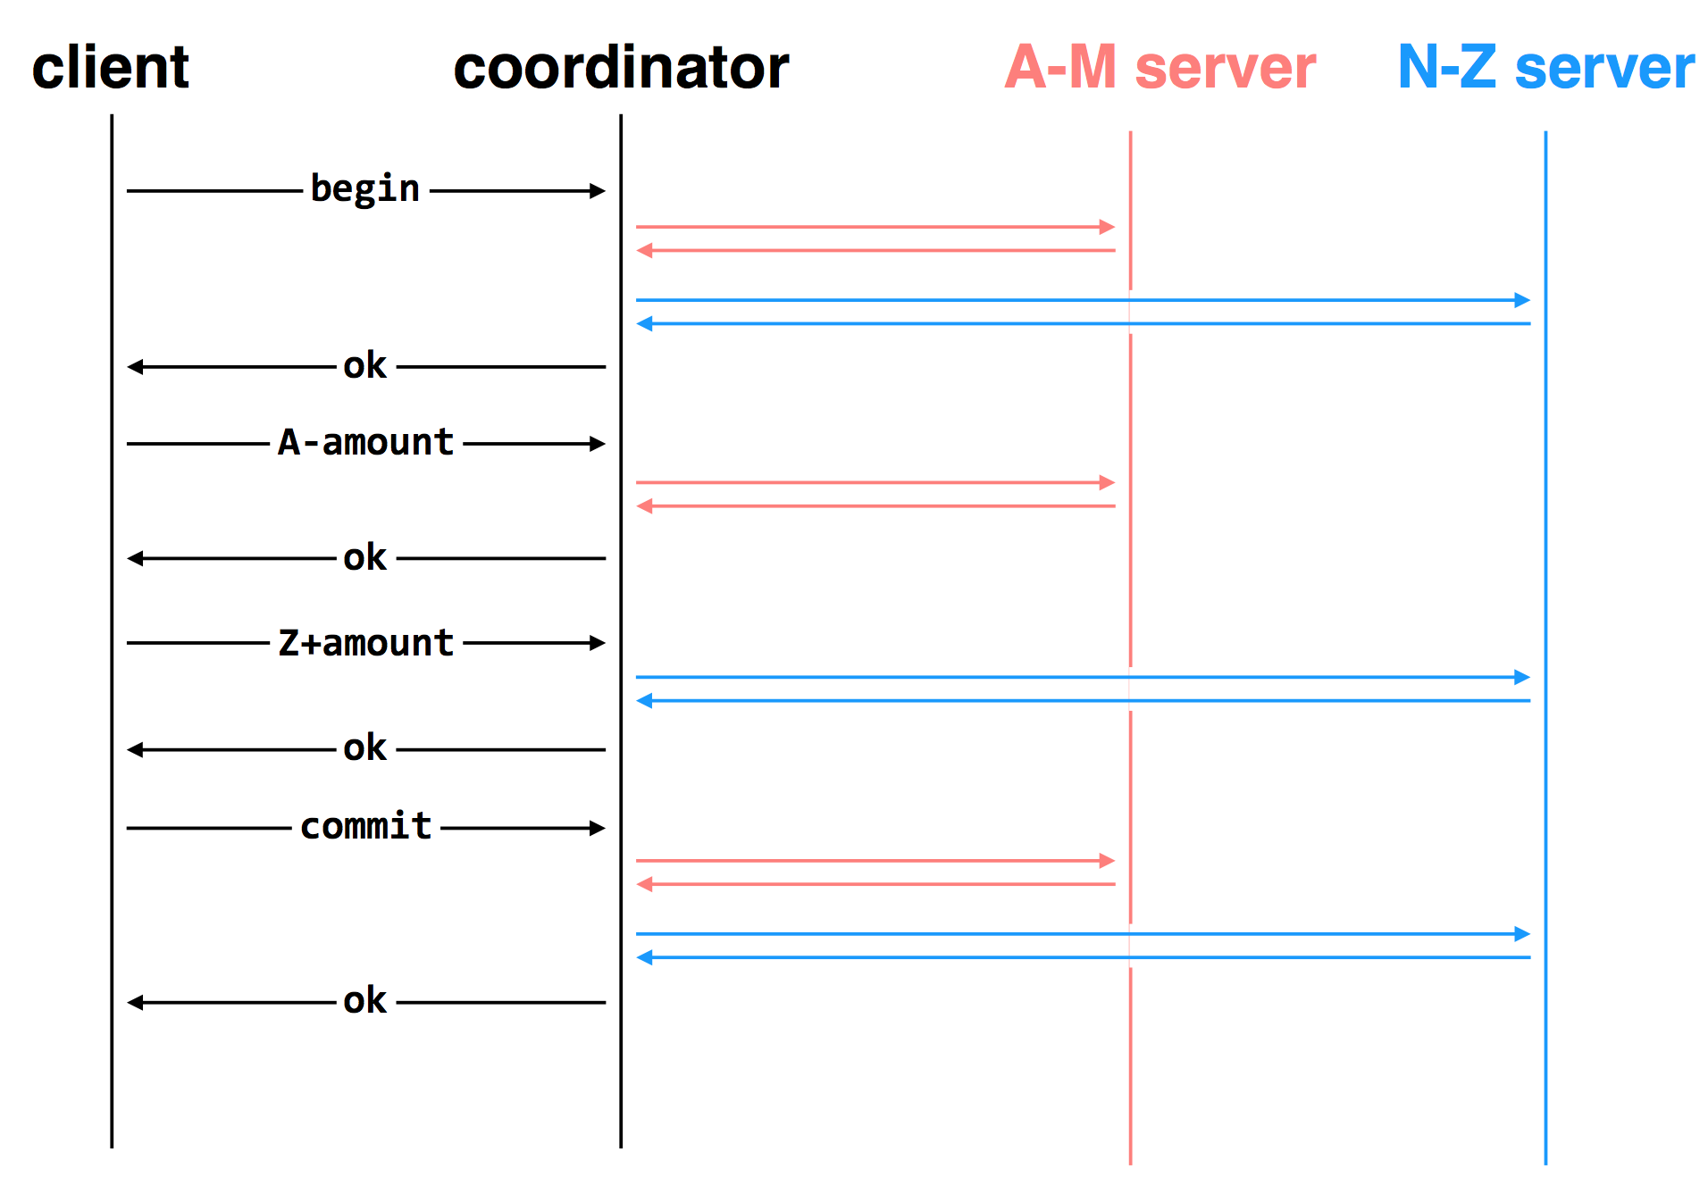

Slide 7
Deal with the Network
Message may be lost, delayed or duplicated
Use RPC to communicate
Ensure at-least-once by persistent sender
Ensure at-most-once by duplicate suppression
However, neither is enough to ensure atomicity here

Slide 8
The Main Problem
Multiple servers can experience different events
One commits while the other crashes, or
One commits while the other aborts, etc.

Slide 9
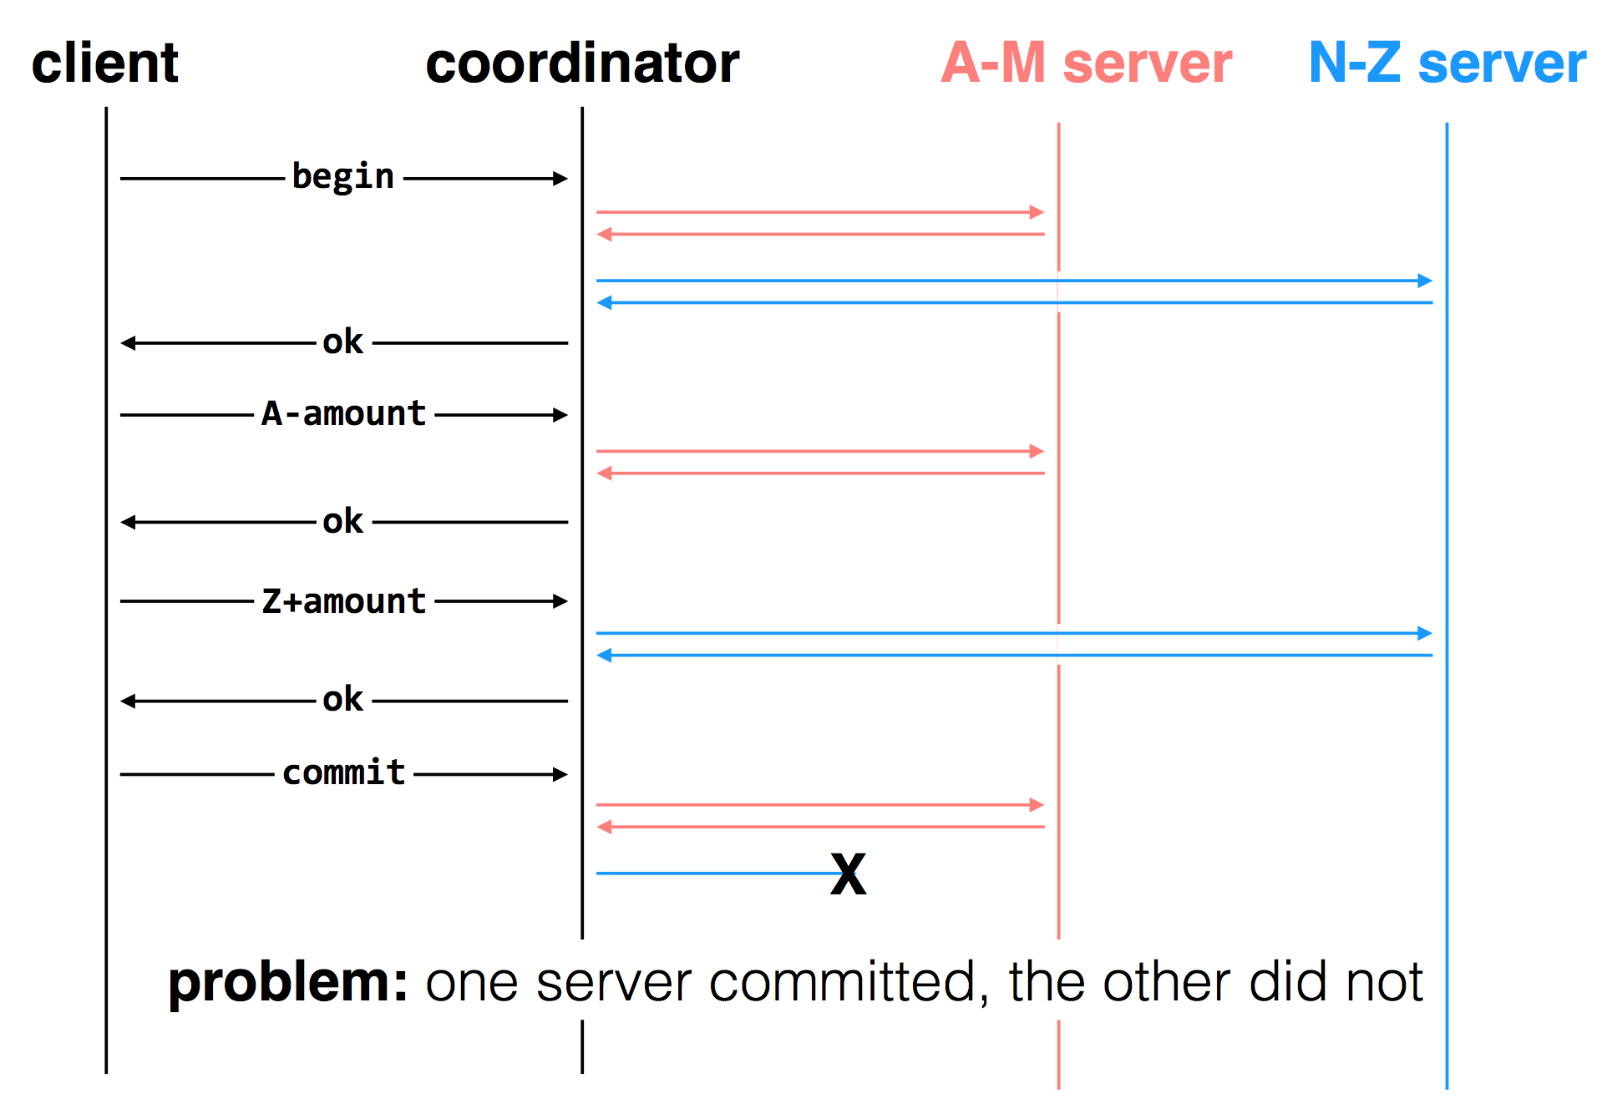

Slide 10
Two-phase Commit
Phase-1: preparation / voting
Lower-layer transactions either aborts or tentatively committed
Higher-layer transaction evaluate lower situation
Phase-2: commitment
If top-layer, then COMMIT or ABORT
If nested itself, then become tentatively committed

Slide 11
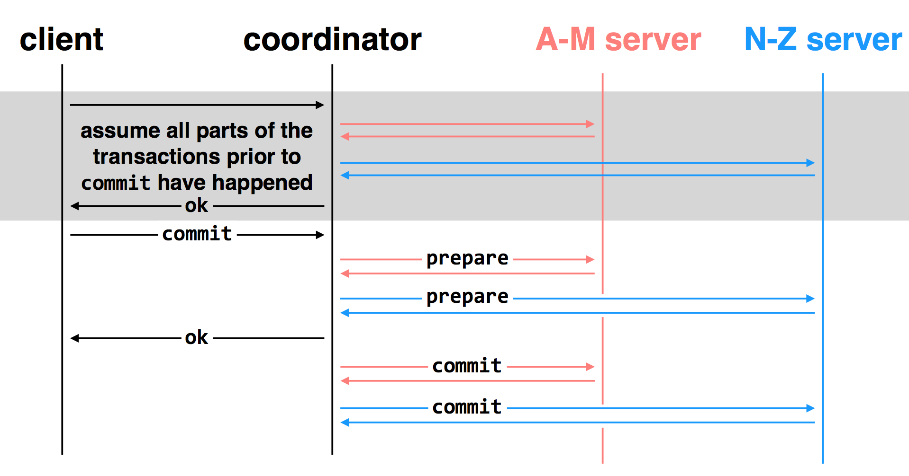
two-phase commit: nodes agree that they are ready to commit before committing

Slide 12
Multiple-site Atomicity
Worker: Bob, Charles, Dawn
Does three transactions: X, Y, Z
Coordinator: Alice
Create a higher-layer transaction
Send three messages to the three workers
Challenge: un-reliable communication

Slide 13
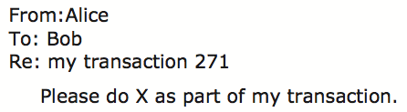
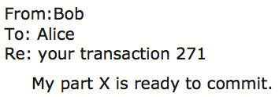
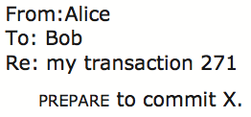
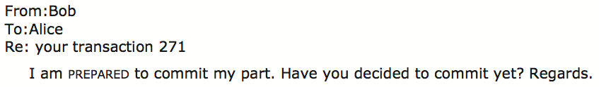
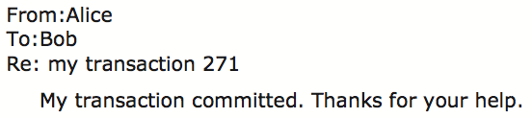
Commit Phase-1
Bob: tentative committed
State: PREPARED
Commit Phase-2
Bob: COMMITTED
Bob will perform post-commit
Notes:
When Bob is PREPARED, what if Alice crash? Bob may wait indefinitely. Here, the coordinator is a single point of failure.
Alice collects PREPARED responses.
After "thanks" from Alice, B,C,D will change from PREPARED to COMMITTED, perform post-commit actions and exit.

Slide 14
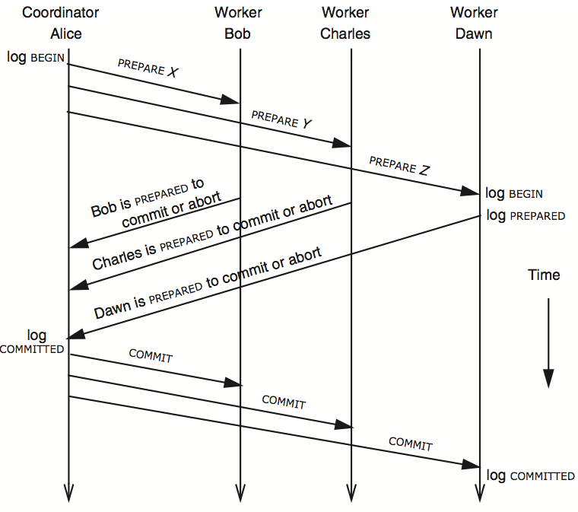
3N messages

Slide 15
Multiple-site Atomicity
Coordinator
Collect some ABORT or nothing: ABORT or assign the work to another worker
Collect all COMMIT: then COMMIT
Worker
When receive nothing: resend PREPARED
Coordinator will send current state if it receives duplicate message
When receive COMMIT: then COMMIT

Slide 16
client
coordinator
A-M server
N-Z server
assume all parts of the transactions prior to
commit have happened
OK
commit
prepare
prepare
OK
commit
commit
two-phase commit: nodes agree that they're ready to commit before committing

Slide 17
client
coordinator
A-M server
N-Z server
OK
commit
X
prepare
timeout; resend
prepare
prepare
OK
commit
commit
failure: lost prepare

Slide 18
client
coordinator
A-M server
N-Z server
OK
commit
prepare
X
timeout; resend
prepare
prepare
OK
failure: lost ACK for prepare

Slide 19

client
coordinator
A-M server
N-Z server
OK
commit
prepare
prepare
abort
abort
failure: worker failure during prepare

Slide 20
client
coordinator
A-M server
N-Z server
OK
commit
prepare
prepare
OK
commit
X
Why? Just wait..
tx?
timeout; resend
commit
commit
failure: lost commit message

Slide 21
client
coordinator
A-M server
N-Z server
OK
commit
prepare
prepare
OK
commit
X
timeout; resend
commit
commit
failure: lost ACK of commit message

Slide 22

client
coordinator
A-M server
N-Z server
OK
commit
prepare
prepare
OK
commit
commit
failure: worker failure during commit

Slide 23
Worker Failure During Commit
If workers fail after the commit point
We cannot abort the transaction
Workers must be able to recover into a prepared state
Workers write PREPARE records to log once prepared
The recovery process will:
Read through the log, and
Indicate which transactions are prepared but not committed

Slide 24

client
coordinator
A-M server
N-Z server
OK
commit
prepare
prepare
OK
commit
commit
tx?
restart
commit
failure: worker failure during commit

Slide 25

client
coordinator
A-M server
N-Z server
OK
commit
prepare
coordinator recovers
abort
abort
failure: coordinator failure during prepare

Slide 26
client
coordinator
A-M server
N-Z server
OK
commit
prepare
prepare
OK
commit
coordinator recovers
commit
commit
failure: coordinator failure during commit

Slide 27
Summary of 2-phase Commit
Two-phase commit allows us to achieve multi-site atomicity: transaction remains atomic even when they require communication with multiple machines
In two-phase commit, failures prior to the commit point can be aborted. If workers (or the coordinator) fail after the commit point, they recover into the PREPARED state, and complete the transaction
Our remaining issue deals with availability and replication: we will replicate data across sites to improve availability, but must deal with keeping multiple copies of the data consistent

Slide 28
Replication Consistency

Slide 29
Replication Consistency
Optimistic Replication
Tolerate inconsistency, and fix things up later
Works well when out-of-sync replicas are acceptable
Pessimistic Replication
Ensure strong consistency between replicas
Needed when out-of-sync replicas can cause serious problems

Slide 30
Optimistic Replication

Slide 31
Consistency of Distributed Files
Resolving Inconsistencies
Suppose we have two computers: laptop and desktop
File could have been modified on either system
How to figure out which one was updated?
One approach: use timestamps to figure out which was updated recently
Many file synchronization tools use this approach

Slide 32
Use of Time in Computer Systems
Time is used by many distributed systems
E.g., cache expiration (DNS, HTTP), file synchronizers, Kerberos, ..
Time intervals: how long did some operation take?
Calendar time: what time/date did some event happen at?
Ordering of events: in what order did some events happen?

Slide 33
Time Measuring
Measuring time intervals
Computer has a reasonably-fixed-frequency oscillator (e.g., quartz crystal)
Represent time interval as a count of oscillator's cycles
time period = count / frequency
e.g., with a 1MHz oscillator, 1000 cycles means 1msec

Slide 34
Time Measuring
Keeping track of calendar time
Typically, calendar time is represented using a counter from some fixed epoch
For example, Unix time is #seconds since midnight UTC at start of Jan 1, 1970
Can convert this counter value into human-readable date/time, and vice-versa
Conversion requires two more inputs: time zone, data on leap seconds
Notes:
[ demo: date +%s shows number of seconds after the Unix epoch ]

Slide 35
Time Measuring
What happens when turn off the computer?
"Real-Time Clock" (RTC) chip remains powered, with battery / capacitor
Stores current calendar time, has an oscillator that increments periodically
Maintaining accurate time
Accuracy: for calendar time, need to set the clock correctly at some point
Precision: need to know oscillator frequency (drift due to age, temp, etc.)

Slide 36
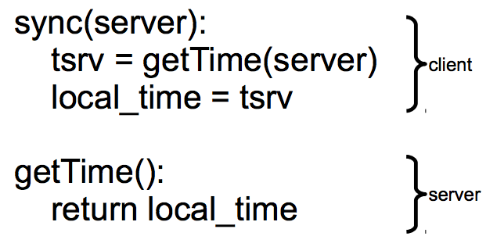
Clock Synchronizing
Synchronizing a clock over the internet: NTP
Query server's time, adjust local time accordingly
Notes:
ntpdate -d 203.17.251.1
% ntpdc -n 203.17.251.1
ntpdc> peers
ntpdate -d ntp.sjtu.edu.cn

Slide 37
Clock Synchronizing
Need to take into account network latency
Simple estimate: RTT/2
When does this fail to work well?
Asymmetric routes, with different latency in each direction
Queuing delay, unlikely to be symmetric even for symmetric routes
Busy server might take a long time to process client's request
Can use repeated queries to average out (or estimate variance) for second two

Slide 38
Estimating Network Latency
sync(server):
t_begin = local_time
tsrv = getTime(server)
t_end = local_time
delay = (t_end-t_begin) / 2
offset = (t_end-delay) - tsrv
local_time = local_time - offset
Notes:
ntpdate -d 203.17.251.1
% ntpdc -n 203.17.251.1
ntpdc> peers

Slide 39
Clock Synchronizing
What if a computer's clock is too fast
E.g., 5 seconds ahead
Naive plan: reset it to the correct time
Can break time intervals being measured (e.g., negative interval)
Can break ordering (e.g., older files were created in the future)
"make" is particularly prone to these errors
Principle: time never goes backwards
Idea: temporarily slow down or speed up the clock
Typically cannot adjust oscillator (fixed hardware)
Adjust oscillator frequency estimate, so counter advances faster / slower

Slide 40
Slew Time
sync(server):
t_begin = local_time
tsrv = getTime(server)
t_end = local_time
delay = (t_end-t_begin) / 2
offset = (t_end-delay) - tsrv
freq = base + ε * sign(offset)
sleep(freq * abs(offset) / ε)
freq = base
timer_intr(): # on every oscillator tick
local_time = local_time + 1/freq
temporarily speed up / slow down local clock

Slide 41
Improving Time Precision
If only adjust our time once
An inaccurate clock will lose accuracy
Need to also improve precision, so we don't need to slew as often
Assumption: poor precision caused by poor estimate of oscillator frequency
Can measure difference between local and remote clock "speeds" over time
Adjust local frequency estimate based on that information
In practice, may want more stable feedback loop (PLL): look at control theory

Slide 42
File Reconciliation with Timestamps
Key Problem
Determine which machine has the newer version of file
Strawman
Use the file with the highest mtime timestamp
Works when only one side updates the file per reconciliation
Notes:
H1: a=1 ->H2
H2: R(a) a=3 ->H1
---
H1: a=1 ->H2
H2: R(a) a=2 ->H1

Slide 43
File Reconciliation with Timestamps
Better plan
Track last reconcile time on each machine
Send file if changed since then, and update last reconcile time
When receiving, check if local file also changed since last reconcile
New Outcome
Timestamps on two versions of a file could be concurrent
Key issue with optimistic concurrency control: optimism was unwarranted
Generally, try various heuristics to merge changes (text diff/merge, etc)
Worst case, ask the user (e.g., if edited same line of code in C file)
Notes:
H1: a=1 ->H2
H2: R(a) a=2 ->H1
H3: R(a) a=3 ->H1

Slide 44
File Reconciliation with Timestamps
Goal: No Lost Updates
V2 should overwrite V1 if V2 contains all updates that V1 contained
Simple timestamps can't help us determine this

Slide 45
Vector Timestamps
Idea: vector timestamps
Store a vector of timestamps from each machine
Entry in vector keeps track of the last mtime
V1 is newer than V2 if all of V1's timestamps are >= V2’s
V1 is older than V2 if all of V1's timestamps are <= V2’s
Otherwise, V1 and V2 were modified concurrently, so conflict
If two vectors are concurrent, one computer modified file without seeing the latest version from another computer
If vectors are ordered, everything is OK as before

Slide 46
Vector Timestamps
Cool property of version vectors:
A node's timestamps are only compared to other timestamps from same node
Time synchronization not necessary for reconciliation w/ vector timestamps
Can use a monotonic counter on each machine
Does calendar time still matter?
More compact than vector timestamps
Can help synchronize two systems that don't share vector timestamps

Slide 47
Pessimistic replication
RSM & Paxos

Slide 48
Pessimistic Replication
Some applications may prefer not to tolerate inconsistency
E.g., a replicated lock server, or replicated coordinator for 2PC
E.g., Better not give out the same lock twice
E.g., Better have a consistent decision about whether transaction commits
Trade-off: stronger consistency with pessimistic replication means:
Lower availability than what you might get with optimistic replication

Slide 49
Single-copy Consistency
Problem of optimistic way: replicas get out of sync
One replica writes data, another doesn't see the changes
This behavior was impossible with a single server
Ideal goal: single-copy consistency
Property of the externally-visible behavior of a replicated system
Operations appear to execute as if there's only a single copy of the data
Internally, there may be failures or disagreement, which we have to mask
Similar to how we defined serializability goal ("as if executed serially")

Slide 50
Replicating a Server
Strawman
Clients send requests to both servers
Tolerating faults: if one server is down, clients send to the other
Tricky case: what if there's a network partition?
Each client thinks the other server is dead, keeps using its server
Bad situation: not single-copy consistency!

Slide 51
Handling Network Partitions
Issue: Clients may disagree about what servers are up
Hard to solve with 2 servers, but possible with 3 servers
Idea: require a majority servers to perform operation
In case of 3 servers, 2 form a majority
If client can contact 2 servers, it can perform operation (otherwise, wait)
Thus, can handle any 1 server failure

Slide 52
Quorum
Define separate read &write quorums: Q_{r} & Q_{w}
Q_{r} + Q_{w} > N_{replicas} (Why?)
Confirm a write after writing to at least Q_{w} of replicas
Read at least Q_{r} agree on the data or witness value
Example
In favor of reading: N_{replicas} = 5, Q_{w} = 4, Q_{r} = 2
In favor or updating: N_{replicas} = 5, Q_{w} = 2, Q_{r} = 4
Enhance availability by Q_{w} = N_{replicas} & Q_{r} = 1

Slide 53
Quorum
Provide no before-or-after or all-or-nothing
If reading & writing requests come from a site
Easy…
If reading from multiple sites, writing from one site
Maintain a version number at that site
If writing from multiple sites
Protocol providing a distributed sequencer
Another complicating consideration
Performance maximization

Slide 54
Simple Implementation: Replicated Logs
Replicated Logs
Log client operations, including both R/W, and numbered
Key issue: agreeing on the order of operations
Coordinator handles one client operation at a time
Coordinator chooses an order for all operations (assigns log sequence number)
Coordinator issues the operation to each replica
When is it OK to reply to client?
Must wait for majority of replicas to reply
Otherwise, if a minority crashes, remaining servers may continue without op

Slide 55
Handling Network Partitions
Why does the majority rule work?
Any two majority sets of servers overlap
Suppose two clients issue operations to a majority of servers
Must have overlapped in at least one server, will help ensure single-copy

Slide 56
Handling Network Partitions
Problem: replicas can become inconsistent
Issue: clients' requests to different servers can arrive in different order
How do we ensure the servers remain consistent?

